Slide 1
E-safety
Raising Awareness

Slide 2
C:\Users\sjenkins\Desktop\ICT\E safety resources\Parents\wheres klaus.wmv

Slide 3

Learning Online?
Communication skills
Money management
Computer skills
Confidence
Commitment
Research
Creativity
Notes:
It is important to illustrate to your audience the positive aspects of being online.
Ask if they believe their child is developing any new skills whilst spending time online? If so, what are they?
Follow up this discussion by reading the suggestions from the slide. Possible answers below.
Answers:
Communication skills – communicating is one of the prime reasons for children going online. They are talking to others, sharing their lives, building connections and friendships. Children have the opportunity to build and maintain connections and communication with a far wider group of people than has been possible in the past.
Computer skills – children are engrossed in technology at a very young age. They see older siblings or family members using computers and Iphones and quickly copy them. How many of your children before the age of 5 knew how to operate your phone or laptop? These skills are then developed and enhanced over time. As technology plays an increasingly important part in all of our lives so does the importance of being able to use it effectively.
Creativity – Through building online spaces and avatars (online characters), online games encourage you to be creative. By using their creativity in this environment children are learning new skills, exploring their imagination and opening their minds to new opportunities.
Research – Children research online. They turn to search engines and other online tools to find out about an interest or piece of history. They are learning how to find and understand complex information from a range of sources and apply this knowledge. Being able to navigate the internet in this way is going to be an increasingly important skill, both in daily life and at work.
Confidence – The internet gives you the ability to be anybody you want to be and try new things. In the real world a child may struggle to build friendships, but online they can be a ‘popular’ king of an online universe (literally!).
Money management – Who here has bought their child online currency, or an online game membership for their child? Children build accounts online and use the currency gained or bought to buy key pieces of online merchandise, such as pets or furniture. Gaming companies suggest that by doing so, they are learning money management. A key lesson is that you can’t buy everything you want and you must work for it. What do you think?
Can anybody think of anything I have missed?

Slide 4
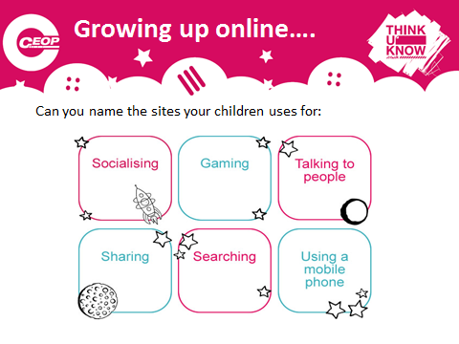
What sites do your children use?

Slide 5
The sites used by children at Helmdon in KS2
Although your child may not use all of the sites you can see on these sheets, they will know about many of them from talking to other children.

Slide 6
E-safety and the new Computing curriculum for KS1

Slide 8
Responsible online behaviour
Primary – Childnet
Digiduck’s big decision

Slide 9
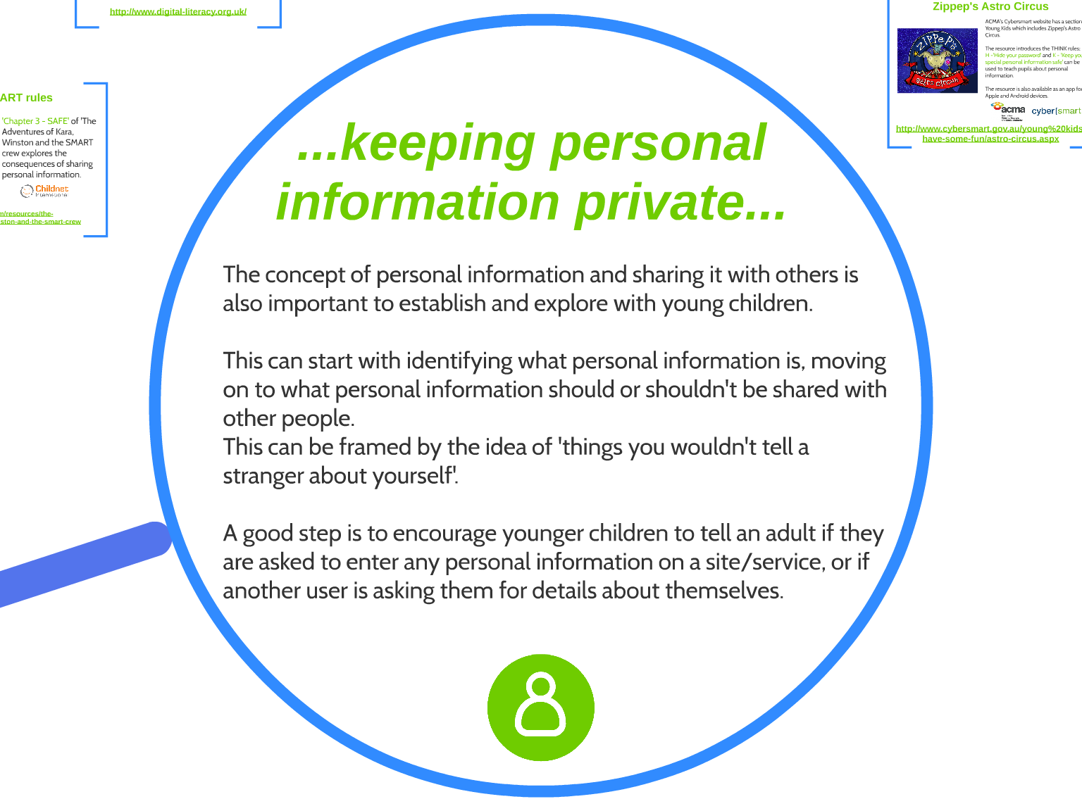

Slide 10

Zippep's Astro Circus: Cybersmart

Slide 11
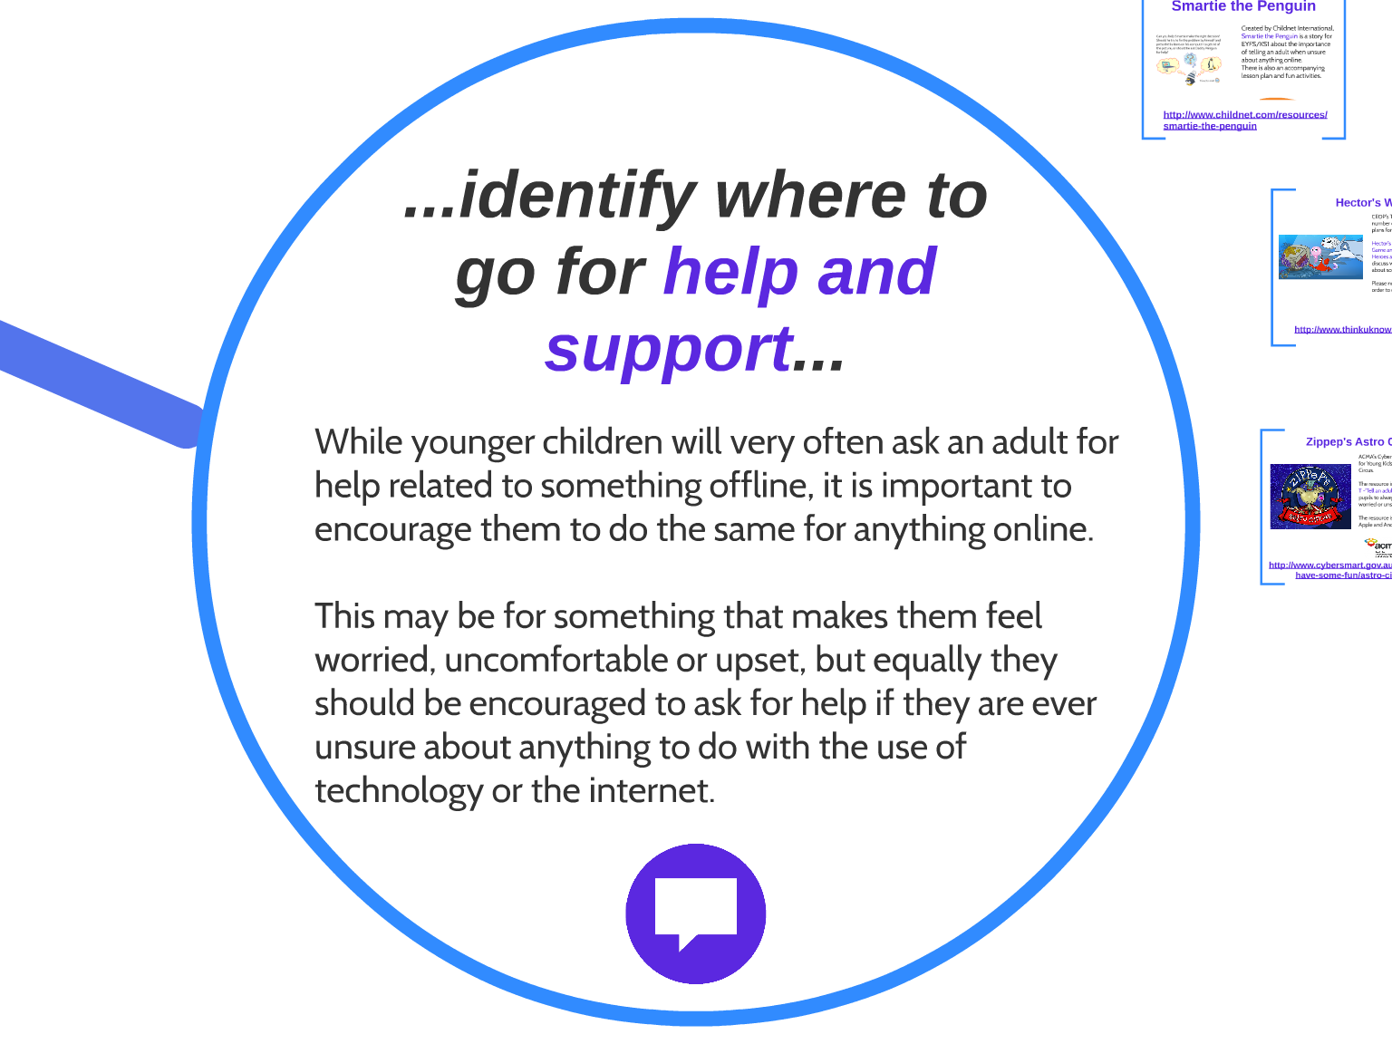

Slide 12

Smartie the Penguin - ebook - Childnet

Slide 13
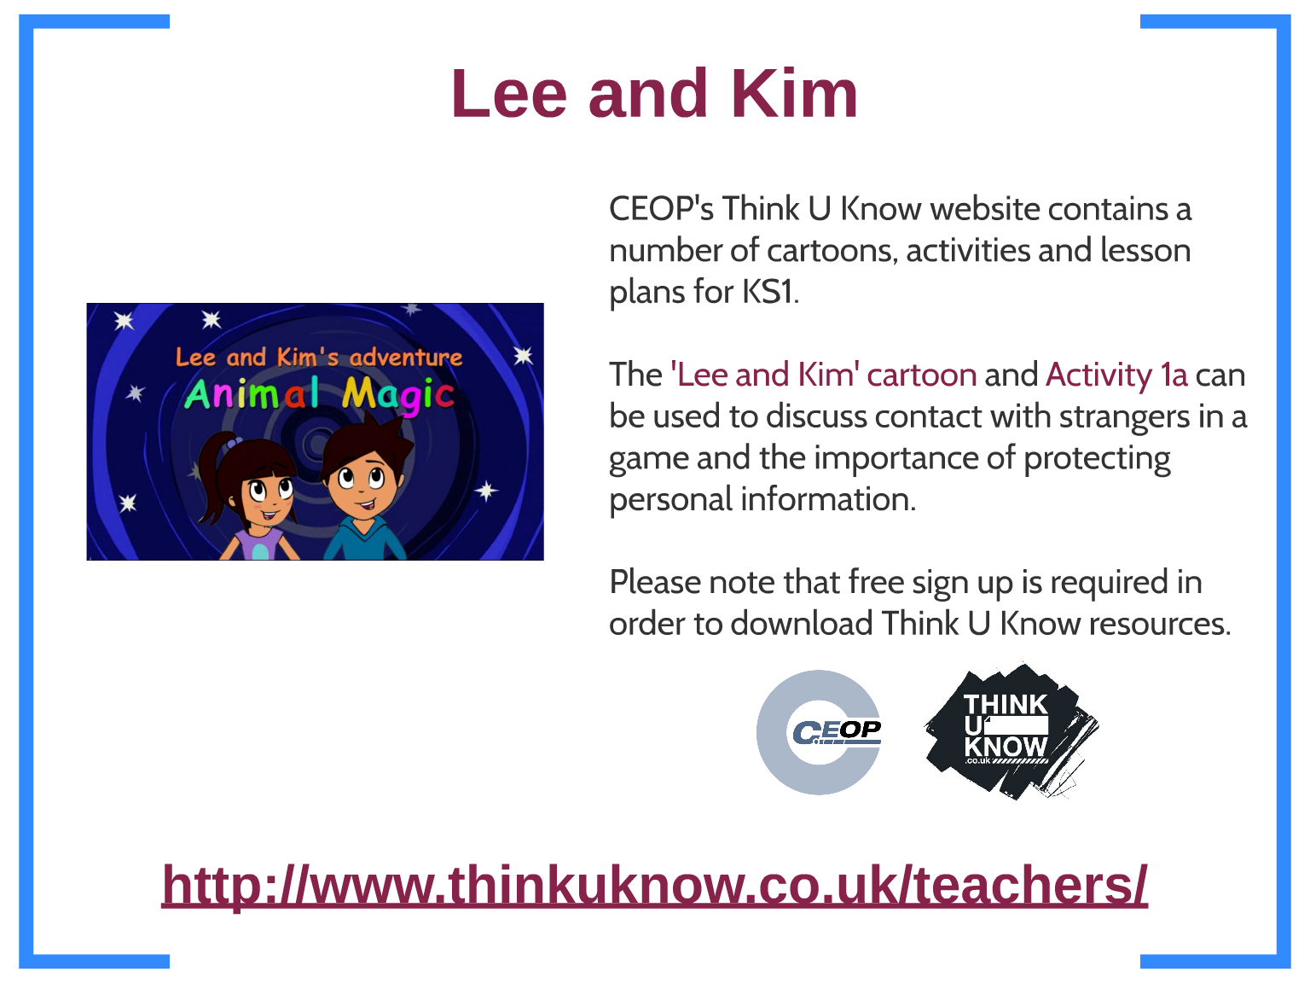
Resources we use in school for KS1

Slide 14

Thinkuknow - home
Get Safe Online | Free online security advice

Slide 15
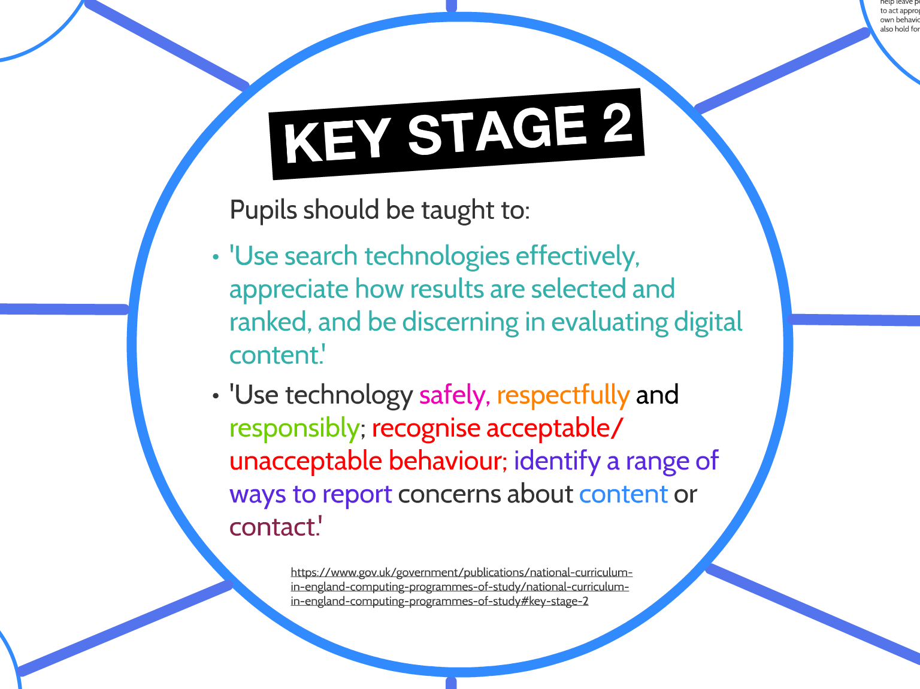
E-safety and the new Computing curriculum for KS2

Slide 16
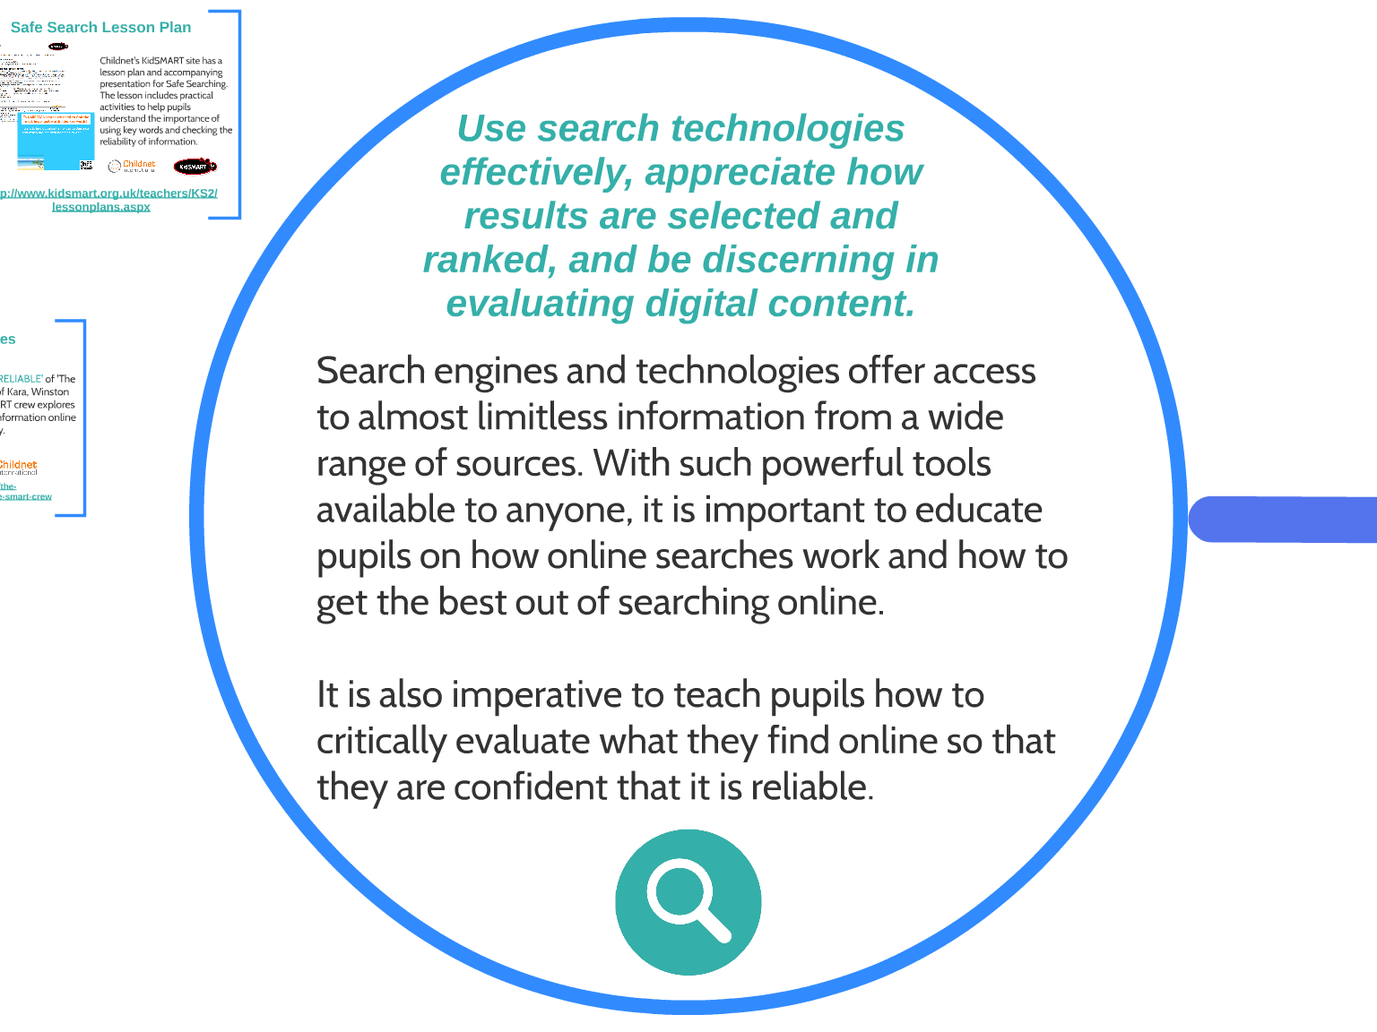

Slide 17
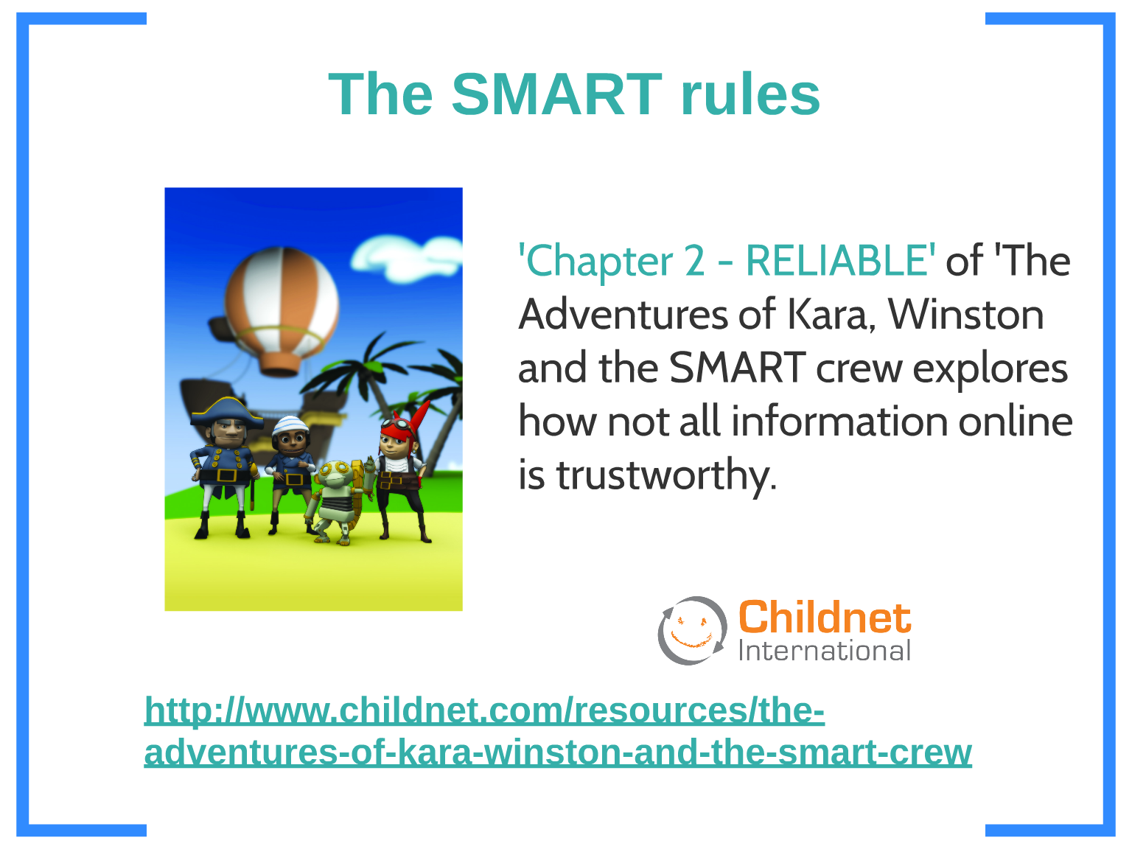
The Adventures of Kara, Winston and the Smart crew - Childnet

Slide 18
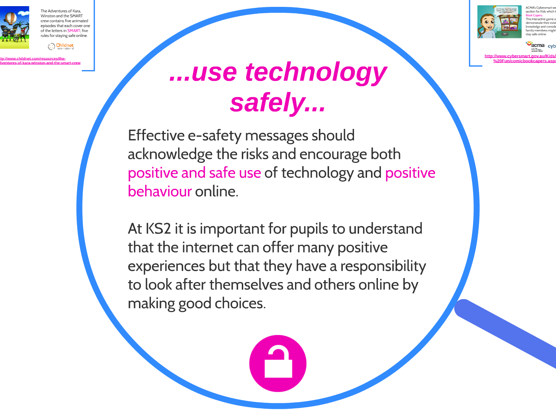

Slide 19
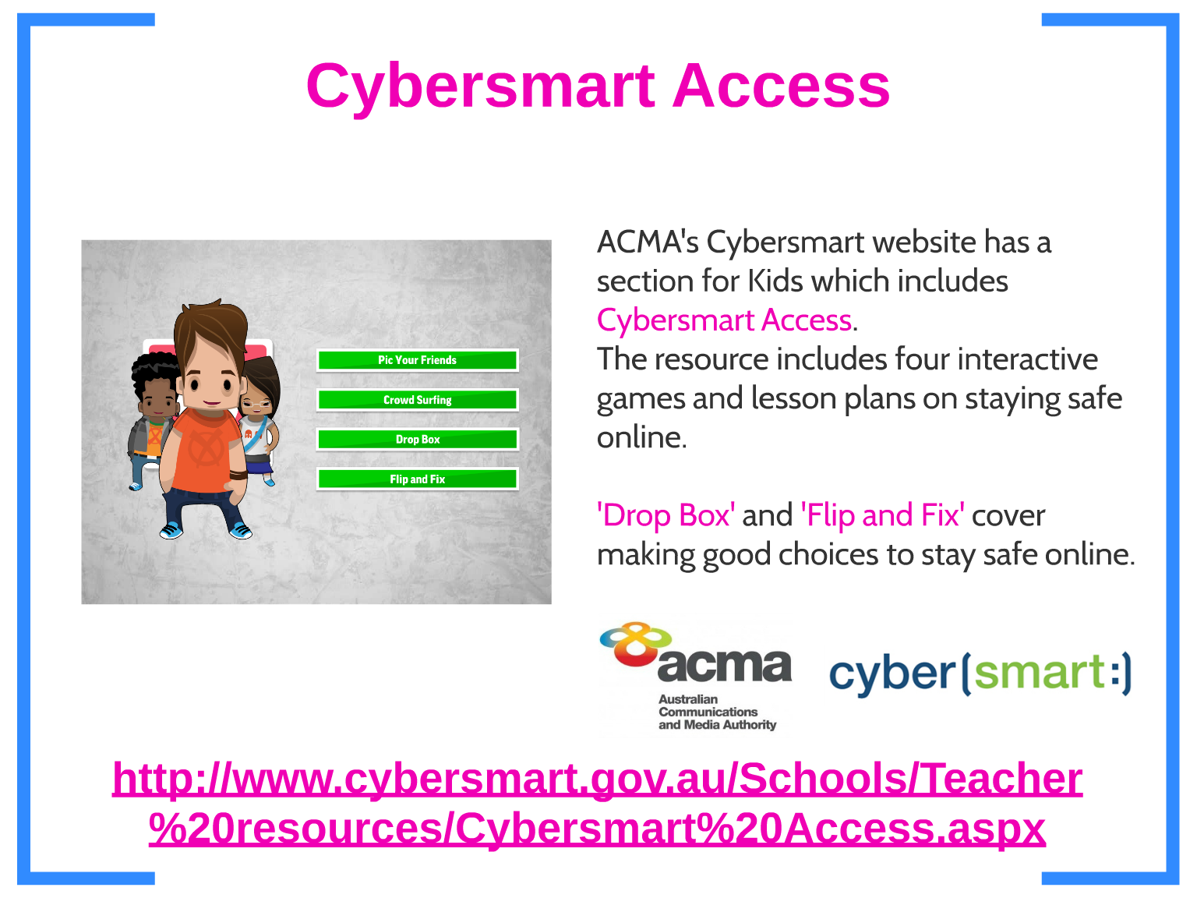
Cybersmart - Internet and mobile safety advice and activities: Cybersmart

Slide 20
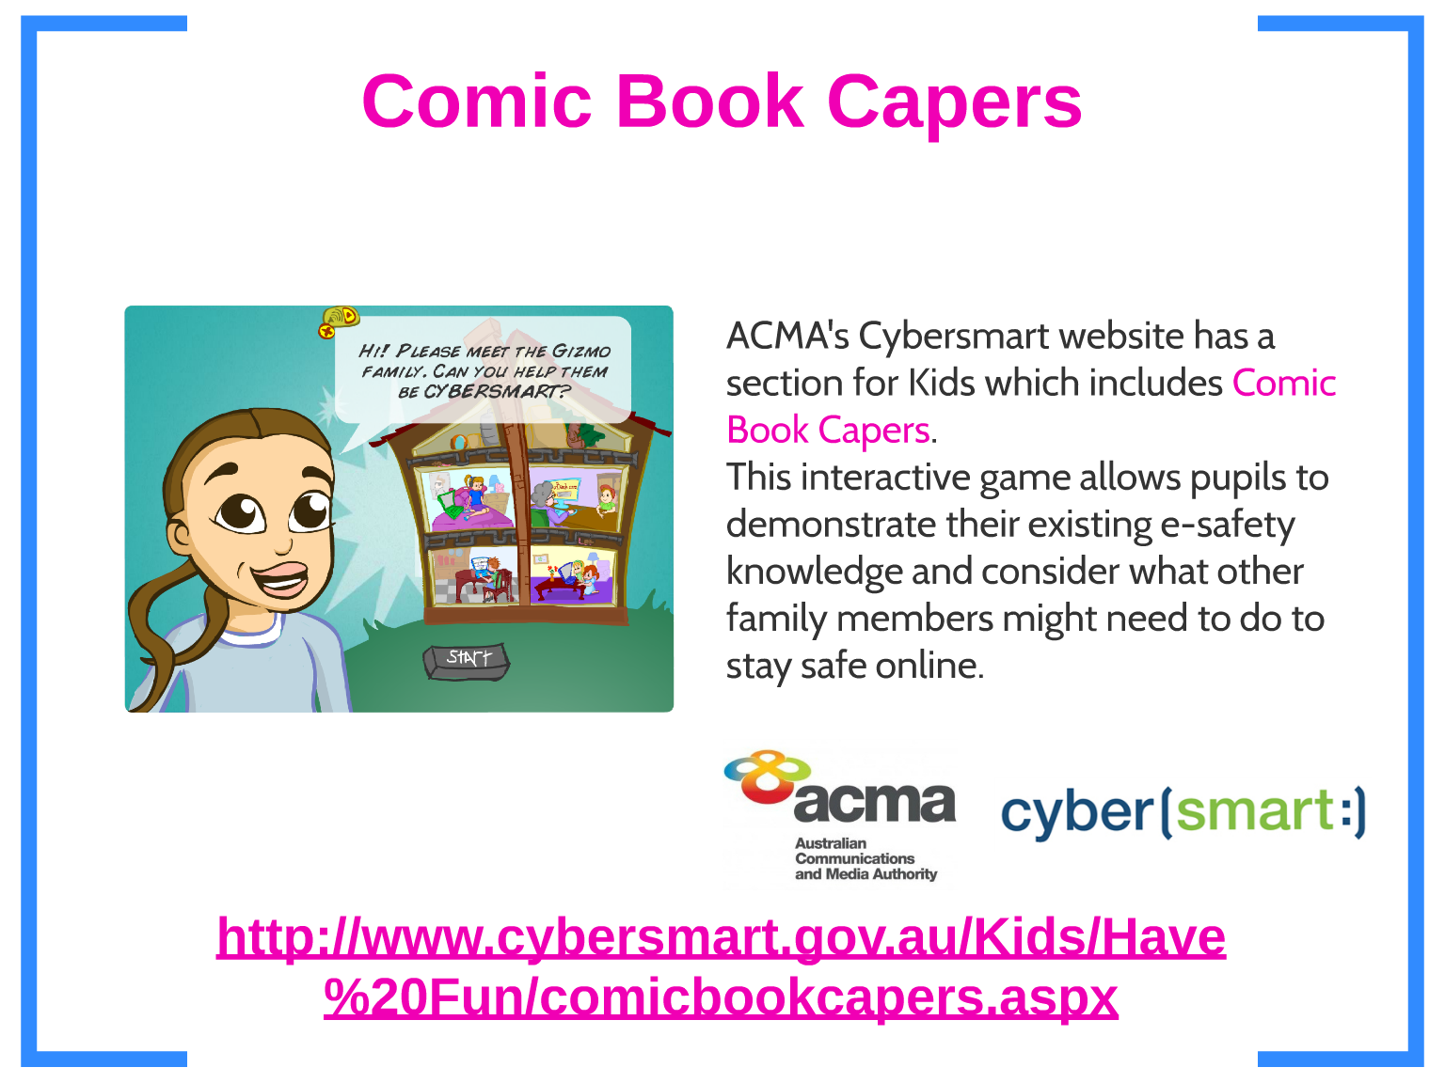
Allowing your child to teach you
Comic book capers: Cybersmart

Slide 21
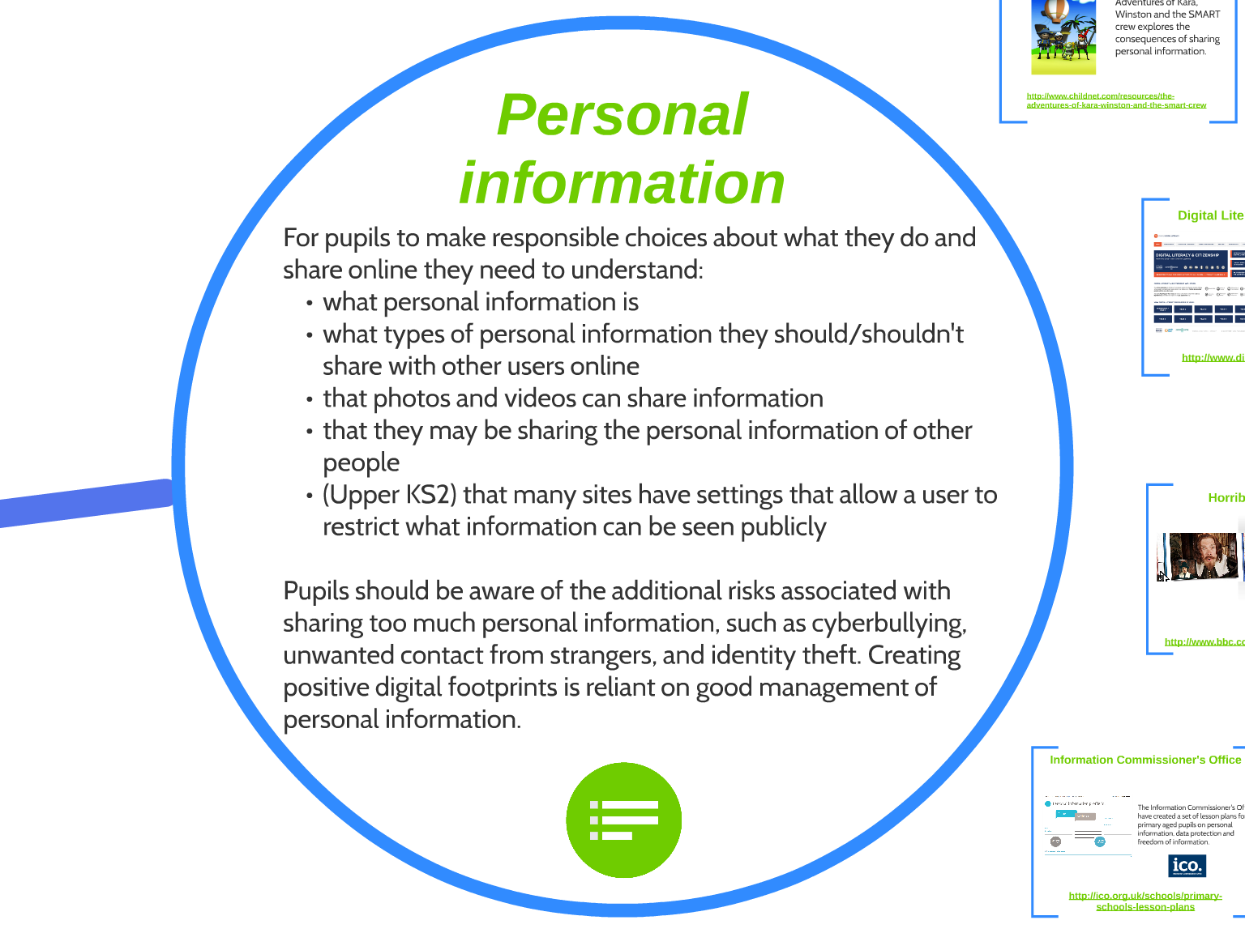

Slide 22
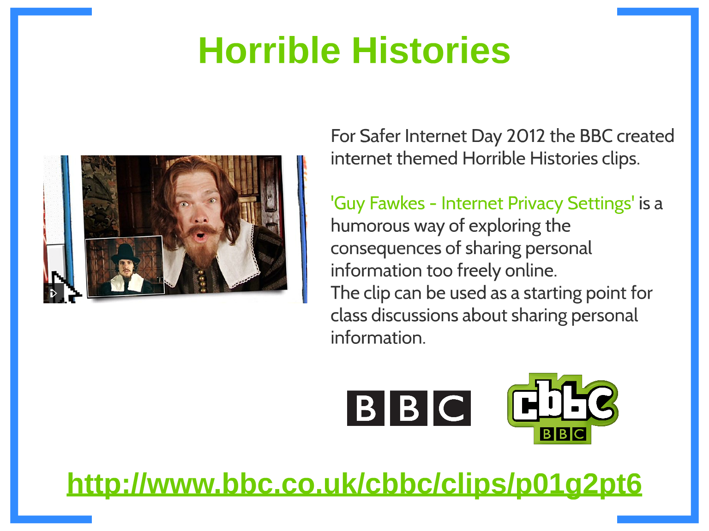
BBC - CBBC - Guy Fawkes - Internet Privacy Settings

Slide 23
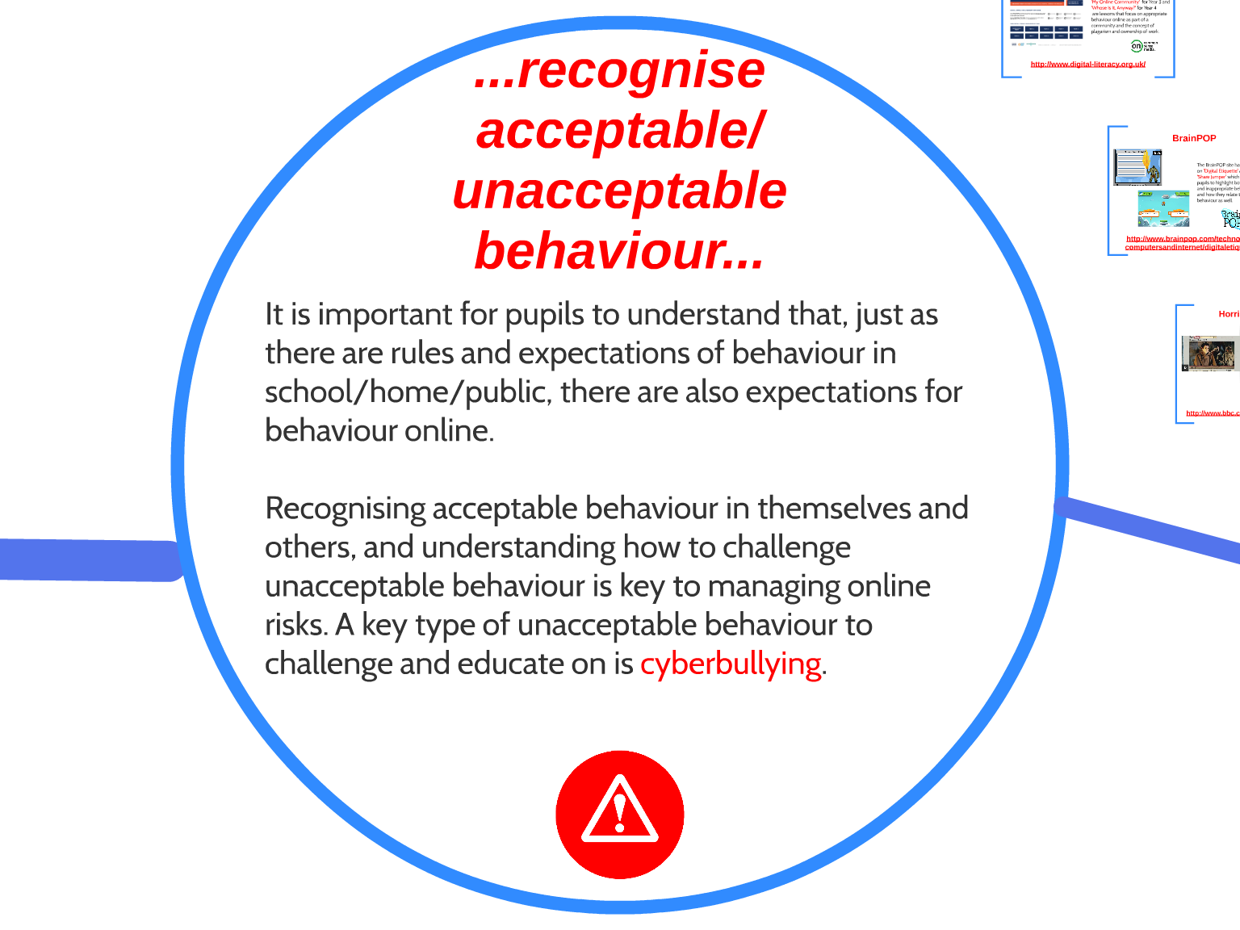

Slide 24
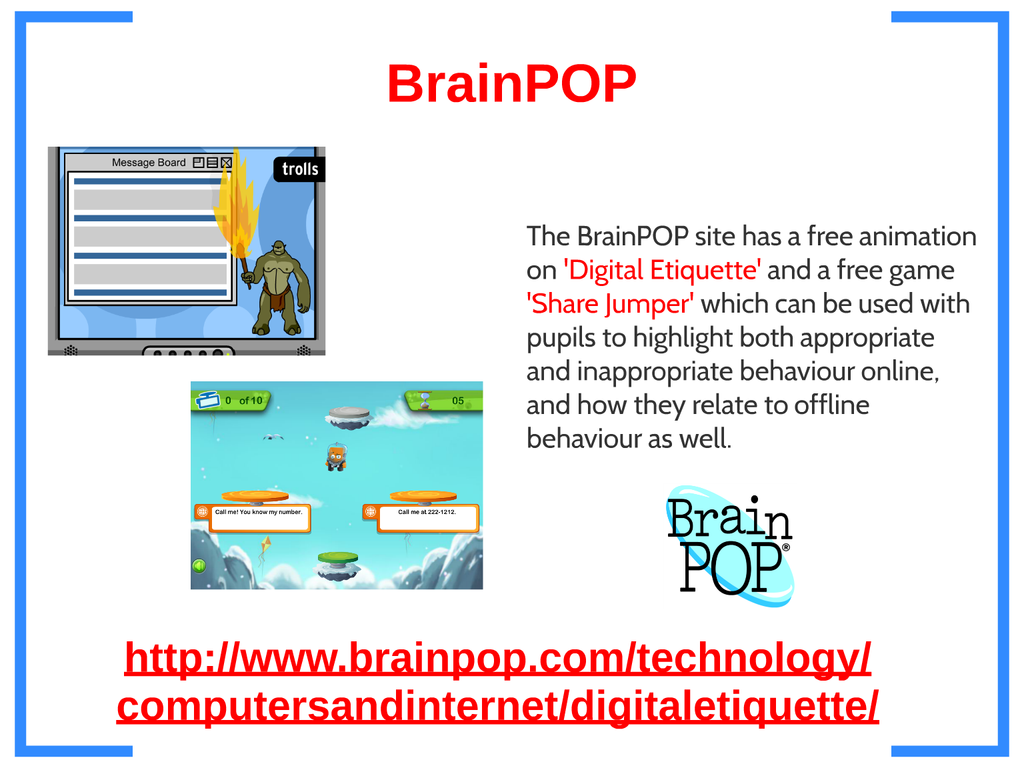
Helmdon's Online Rules EYS KS1 KS2.docx
BrainPOP | Digital Etiquette

Slide 25
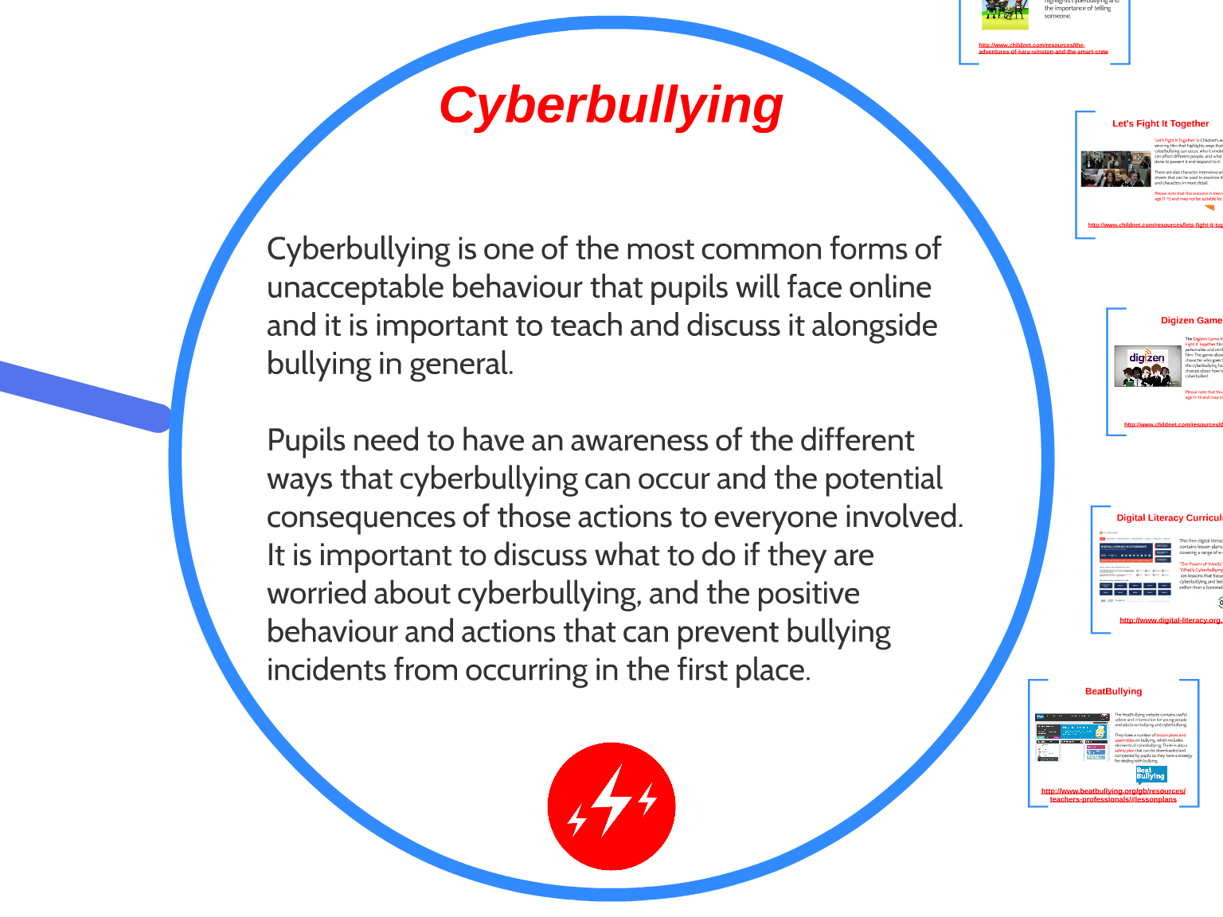

Slide 26
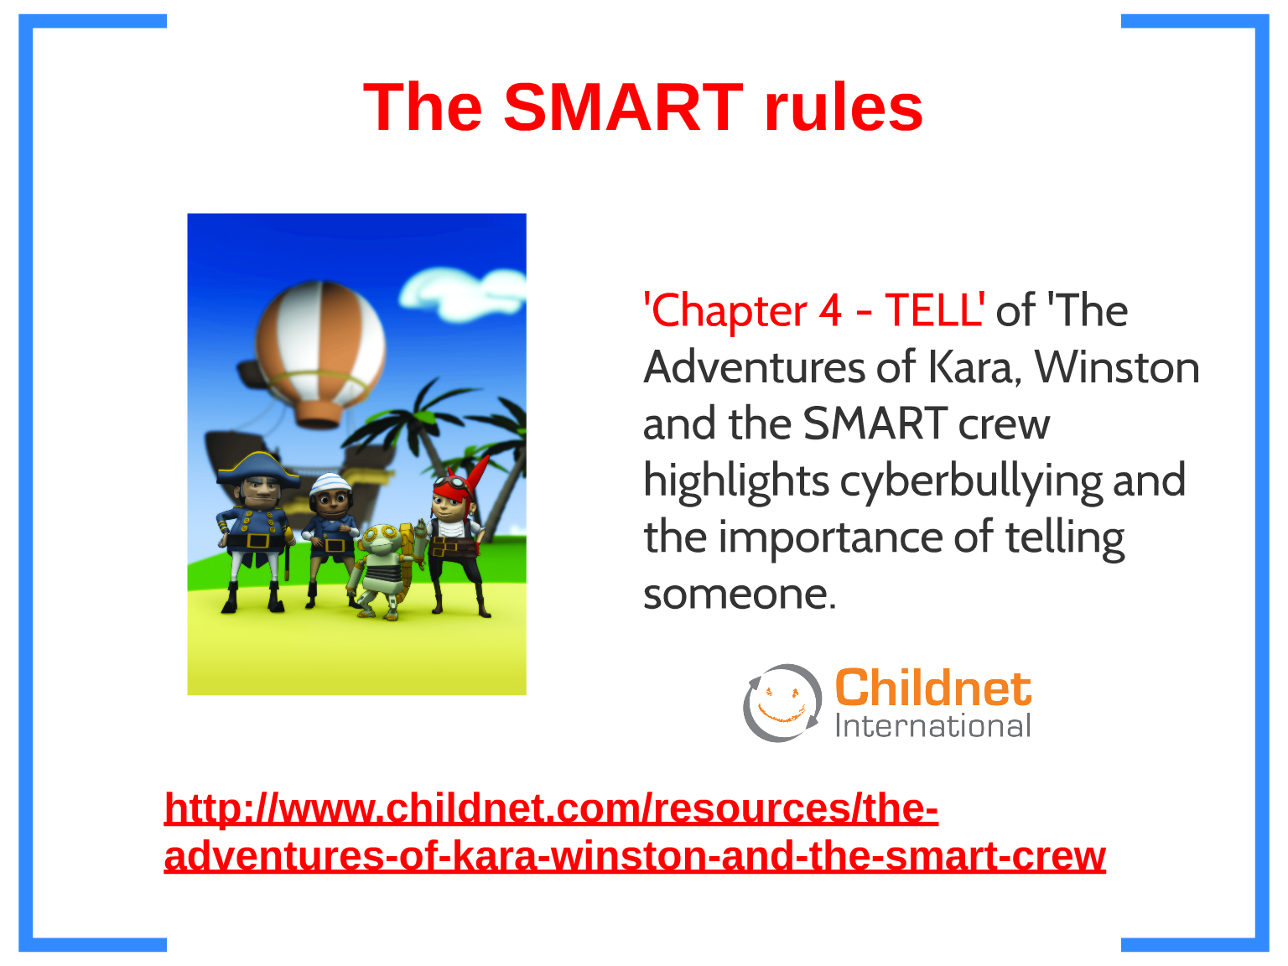
The Adventures of Kara, Winston and the Smart crew - Childnet

Slide 27
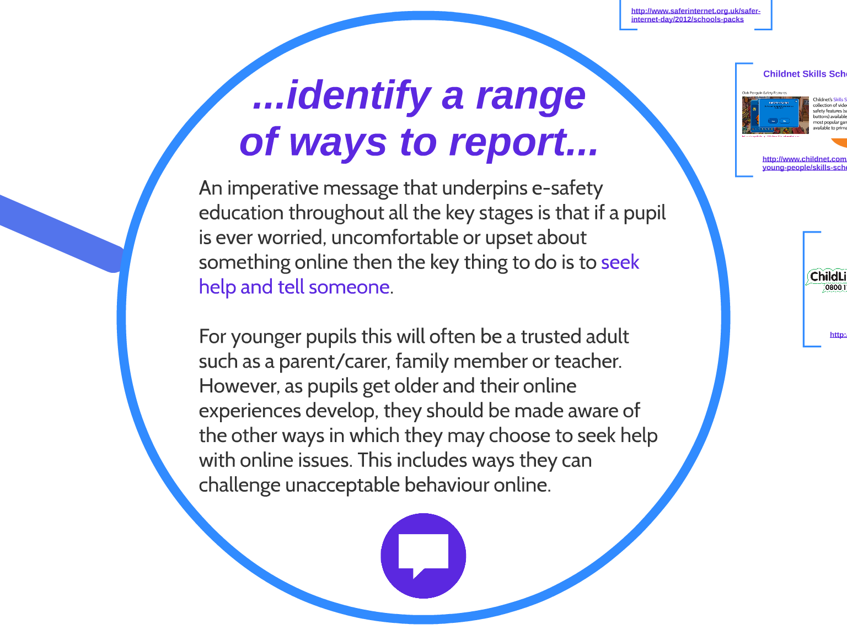

Slide 28
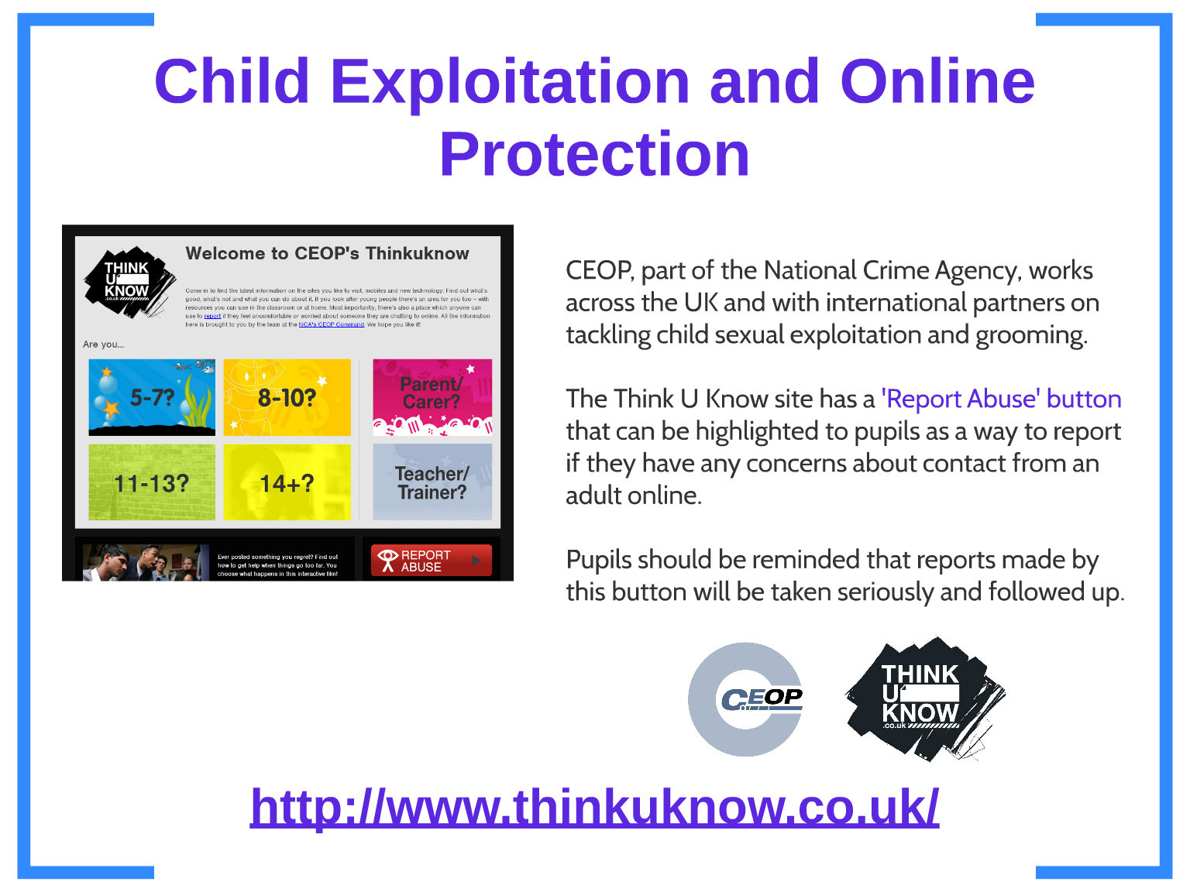
Thinkuknow - home

Slide 29
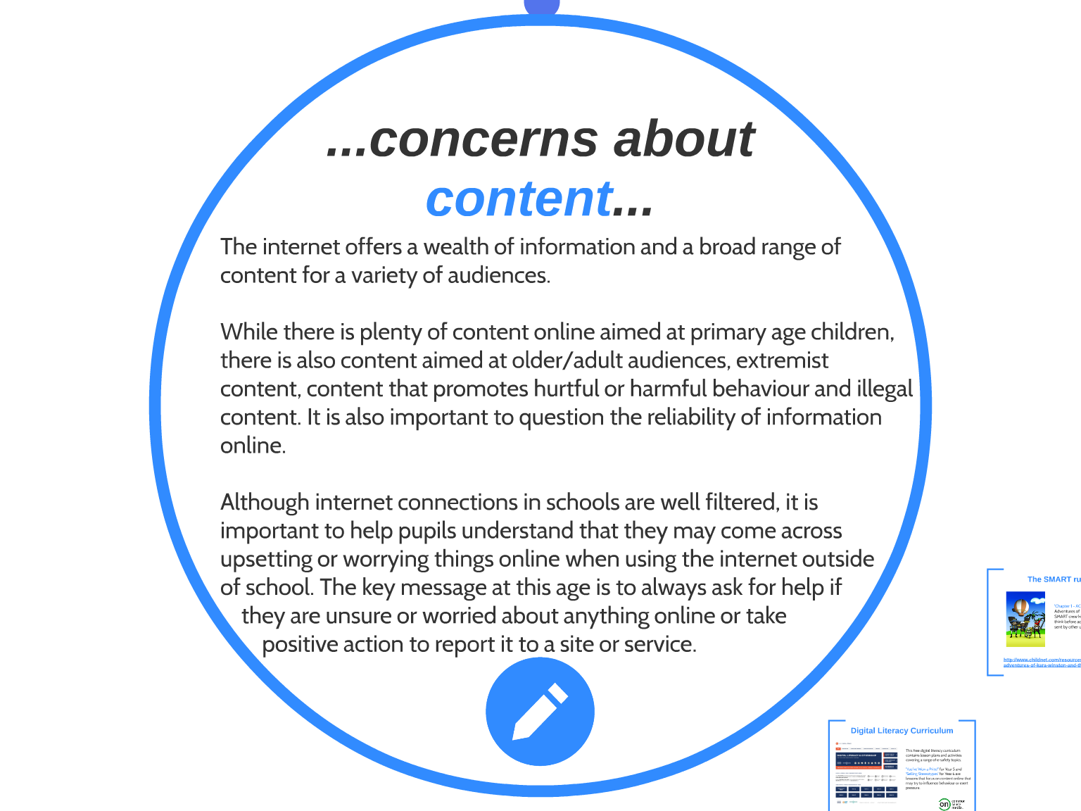

Slide 30
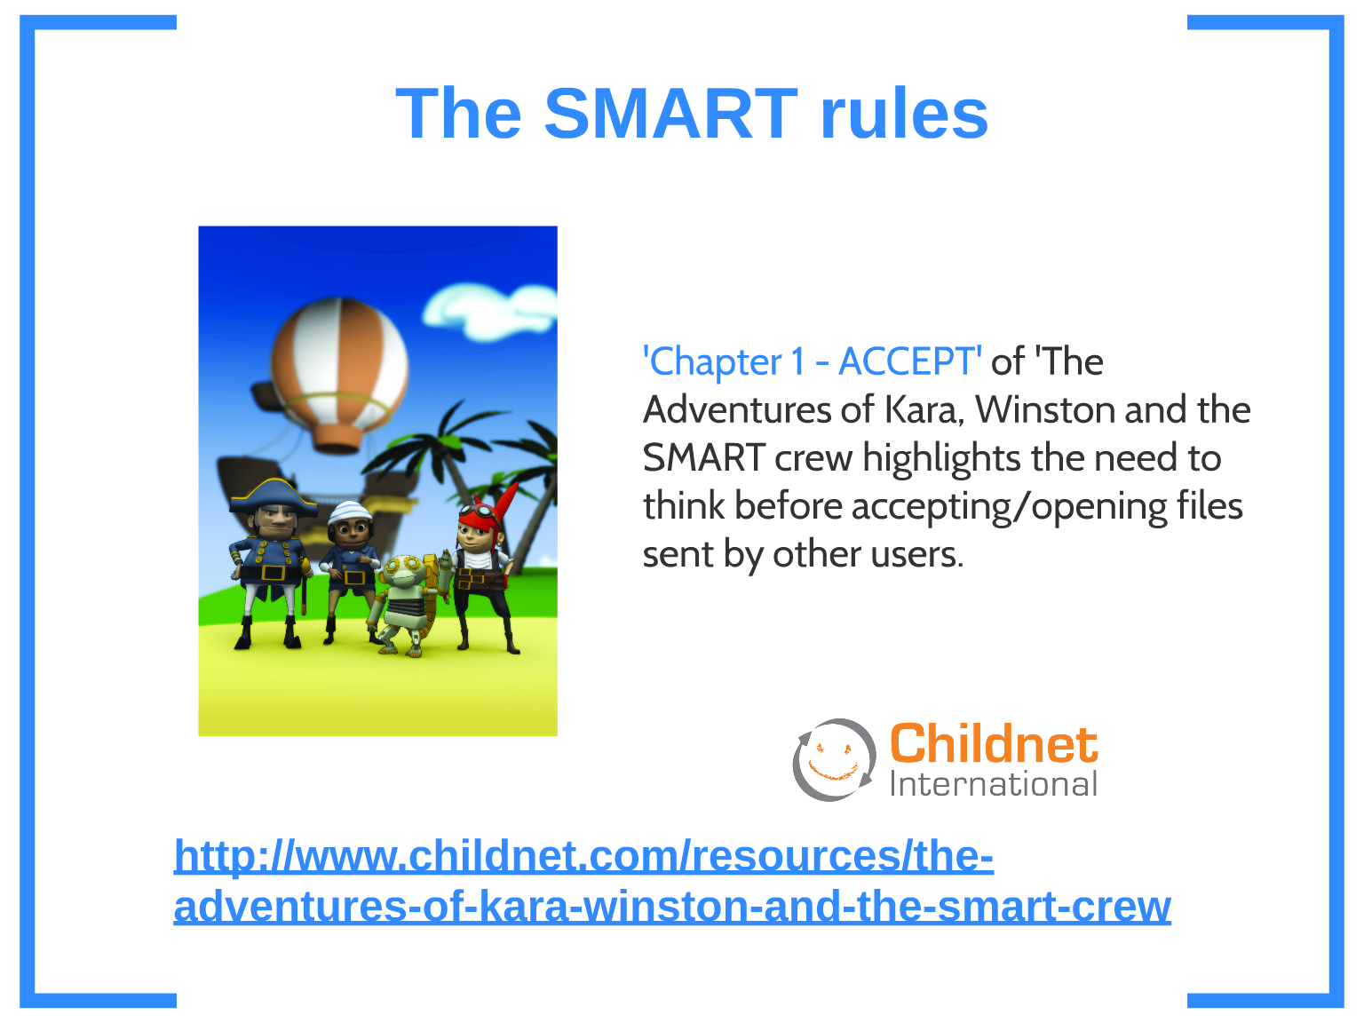

Slide 31
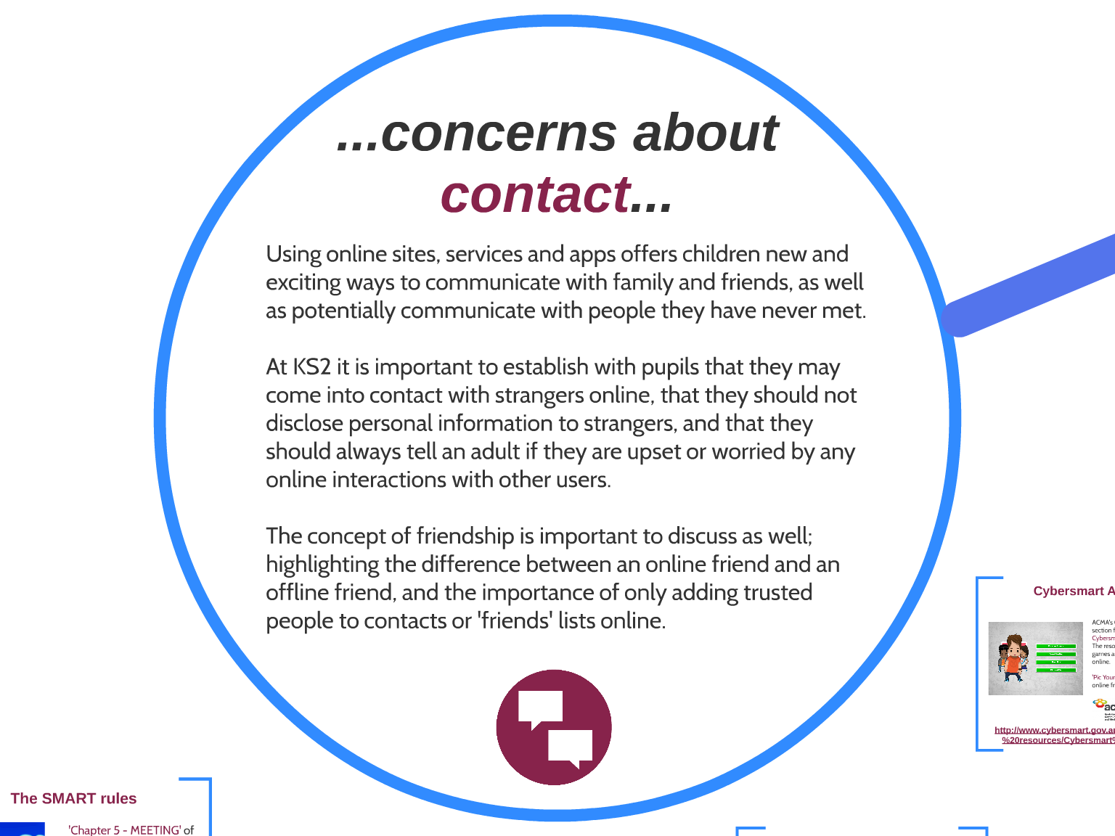

Slide 32
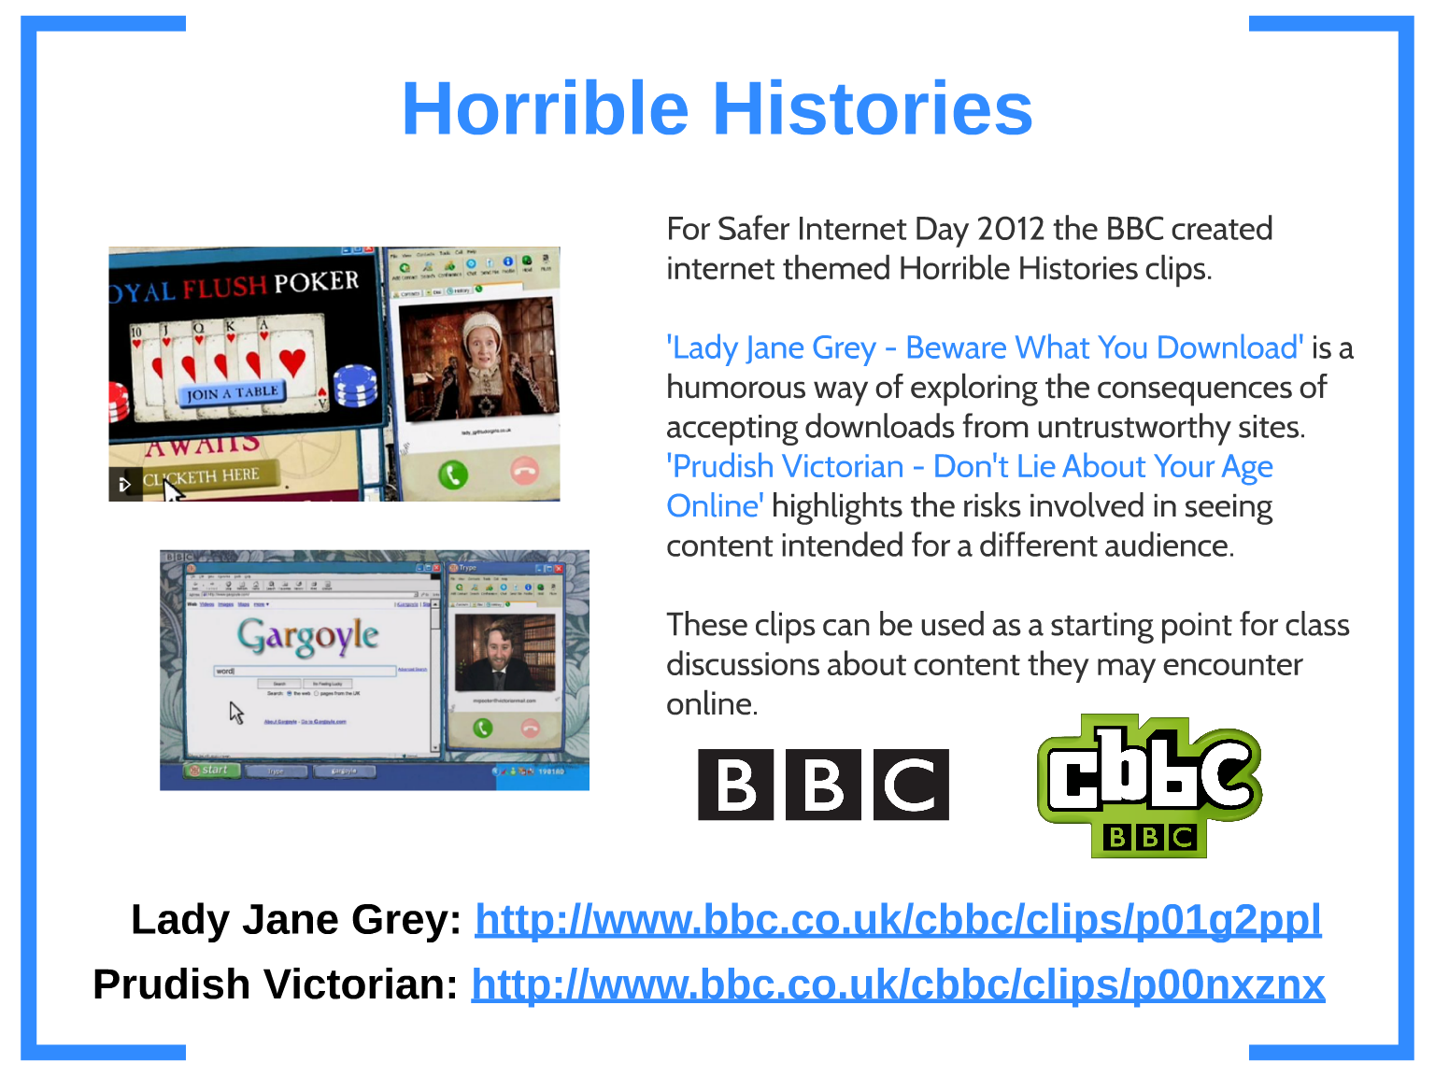

Slide 33
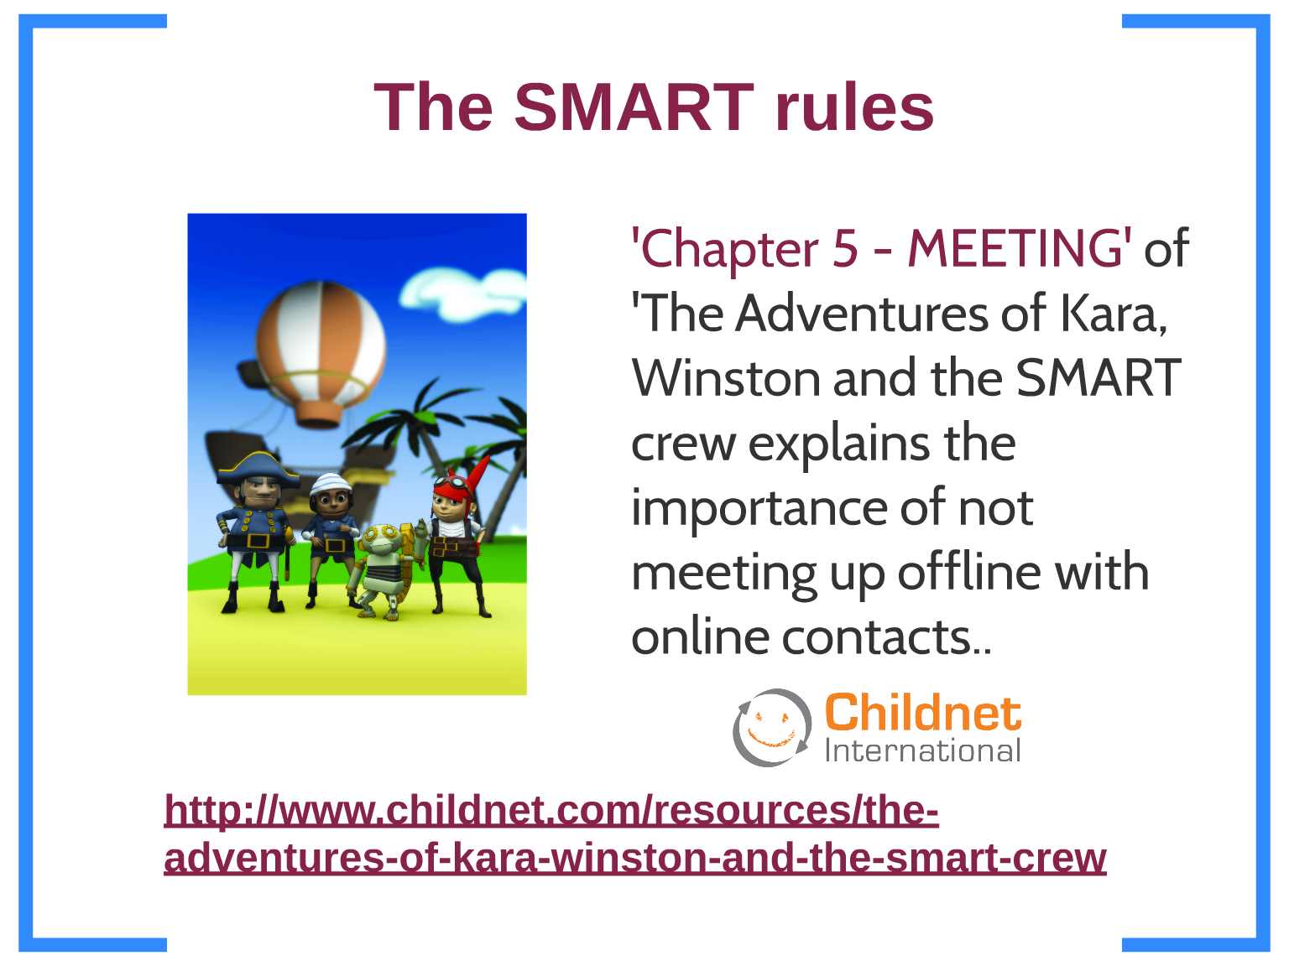

Slide 34
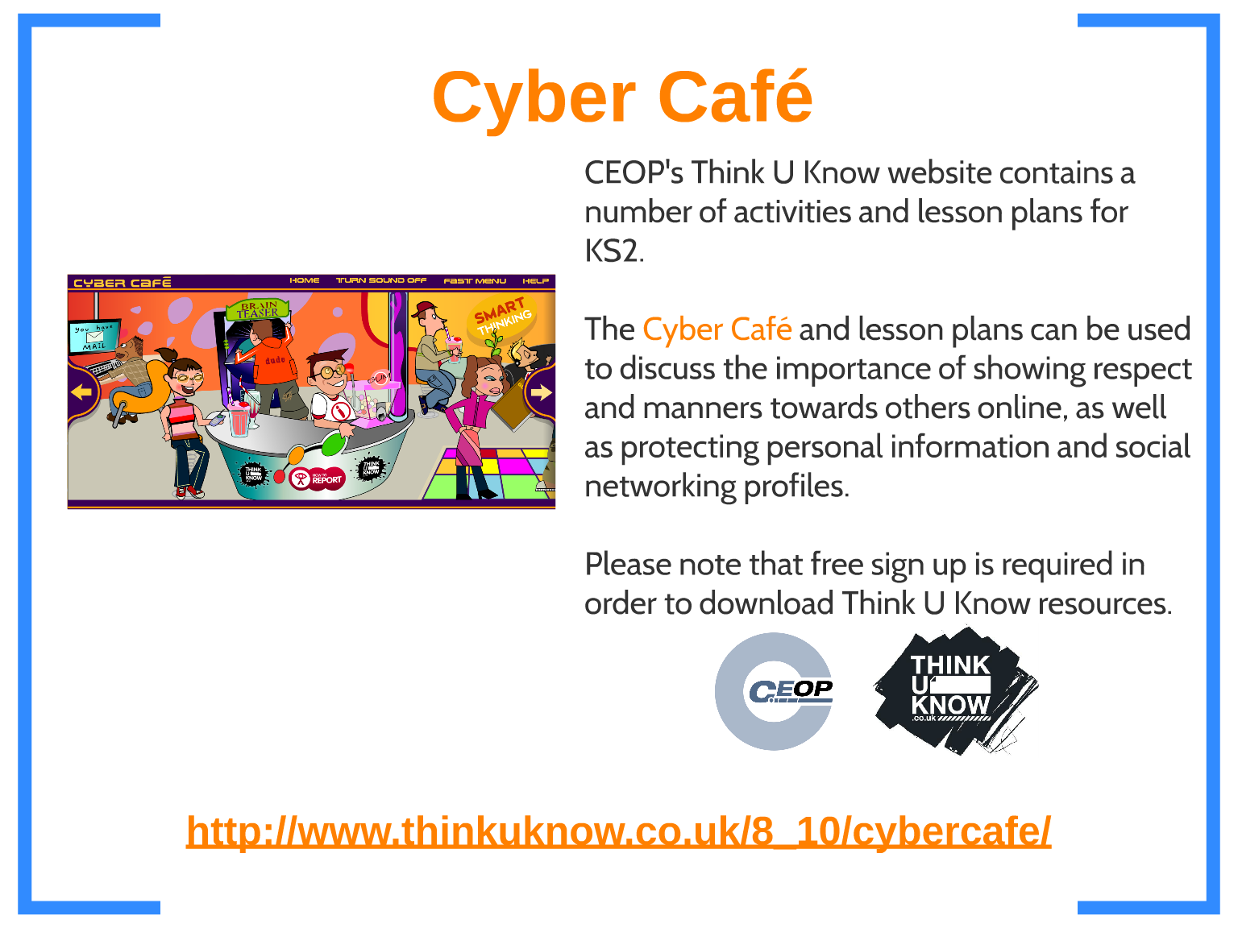
Resources we use in school for KS2
Thinkuknow - home

Slide 35
E-safety cadets
Home : eCadets

Slide 36
Safer Internet Day
Safer Internet Day - www.saferinternet.org

Slide 37
..\E safety resources\Supporting-young-people-online parents.pdf
Share Aware | NSPCC

Slide 38
..\E safety resources\Parents\changing filter on google search engine.docx
Google

